Slide 1
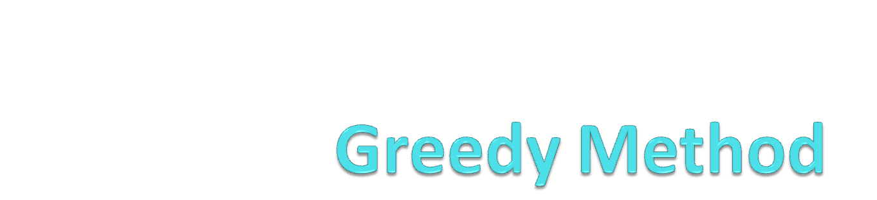

Slide 2


Definition…..
Greedy algorithm always make a choice that looks best at the moment
A wants to take Money from B
So if A is greedy then he will think about at this moment only that at any how he will get the money from B without thinking the consequences which may occur in future with respect to their relationship
So at that point you have to take decision that what is best for you and that is a greedy algorithm

Slide 3
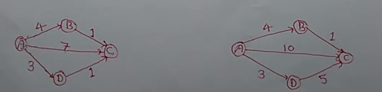
Properties of greedy methods
Greedy Choice properties
It makes locally optimal choice in the hope that this choice lead to globally optimal solution
Optimal substructure
Optimal solution contain optimal sub-solution.
Local Optimal choice is : A to D i.e. 3 weight

Slide 4
Problem Definition . . .
Suppose that a problem can be solved by a sequence of decisions. The greedy method has that each decision is locally optimal. These locally optimal solutions will finally add up to a globally optimal solution.
Only a few optimization problems can be solved by the greedy method.
e.g.
Dijkstra's shortest path algorithm
Prim's algorithm
Kruskal algorithm
Huffman Coding

Slide 5
Examples
The vehicle routing problem (VRP)
  A number of goods need to be moved from certain pickup locations to other delivery locations. The goal is to find optimal routes for a fleet of vehicles to visit the pickup and drop-off locations.
Travelling salesman problem
  Given a list of cities and their pair wise distances, the task is to find a shortest possible tour that visits each city exactly once.
Coin Change
  (making change for n $ using minimum number of coins)
The knapsack problem
The Shortest Path Problem

Slide 6
More example
Problem: Pick k numbers out of n numbers such that the sum of these k numbers is the largest.
Algorithm:
    FOR i = 1 to k
    pick out the largest number and
    delete this number from the input.
    ENDFOR

Slide 7
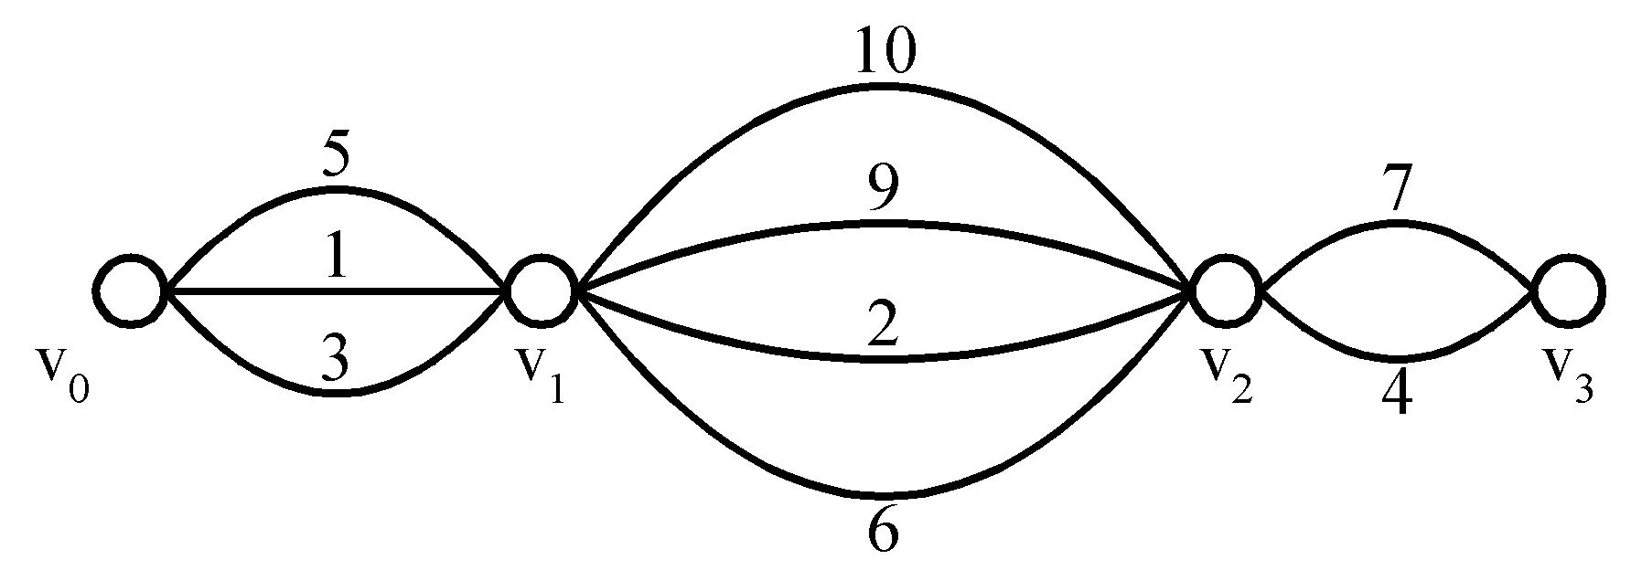
Shortest paths on a special graph
Problem: Find a shortest path from v₀ to v₃.
The greedy method can solve this problem.
The shortest path: 1 + 2 + 4 = 7.

Slide 8
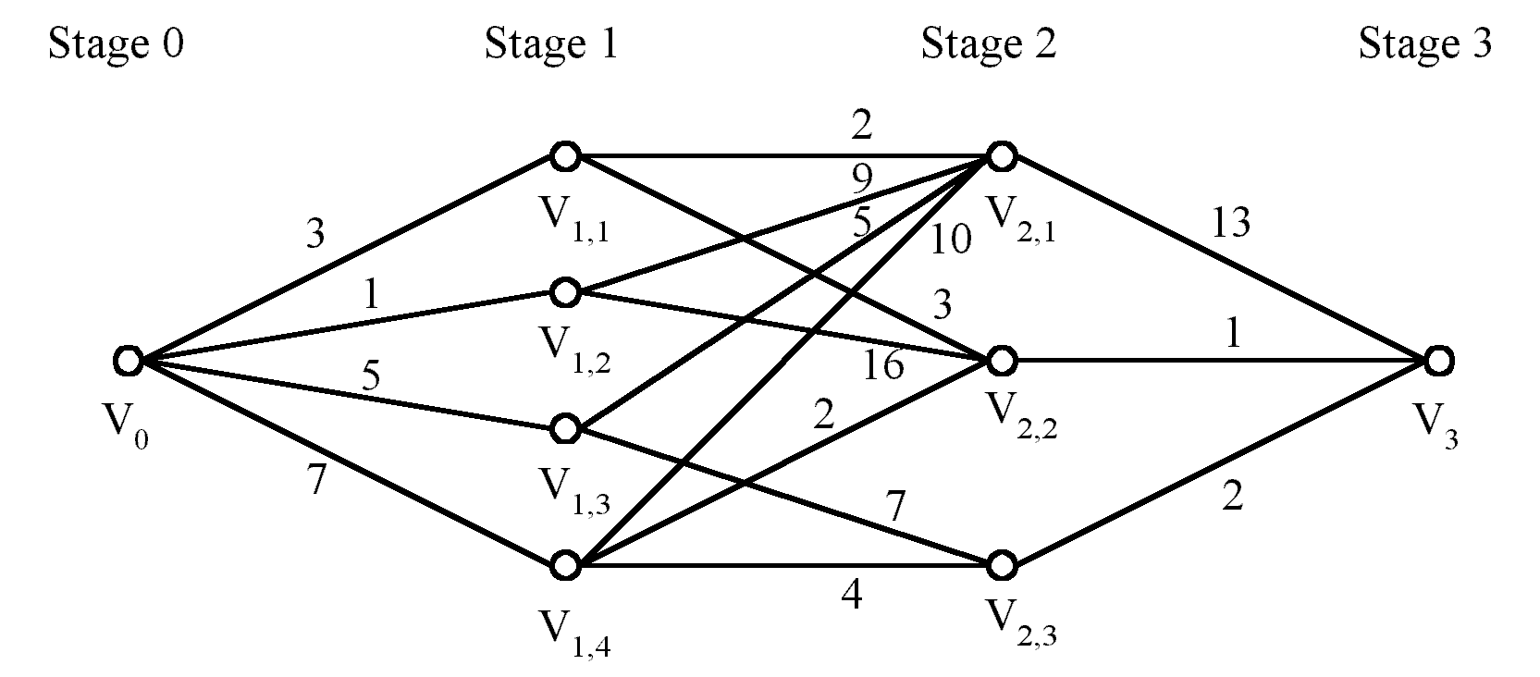
Shortest paths on a multi-stage graph
Problem: Find a shortest path from v₀ to v₃ in the
multi-stage graph.
Greedy method: v₀v_{1,2}v_{2,1}v₃ = 23
Optimal: v₀v_{1,1}v_{2,2}v₃ = 7
The greedy method does not work.
Greedy method: v₀v_{1,2}v_{2,1}v₃ = 23
Optimal: v₀v_{1,1}v_{2,2}v₃ = 7
The greedy method does not work.

